Slide 1
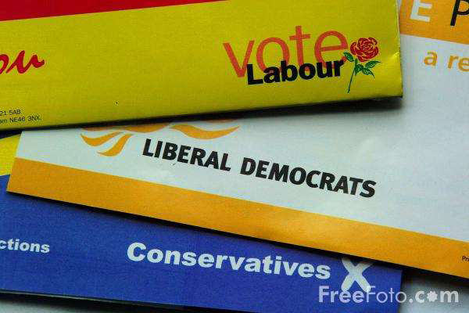
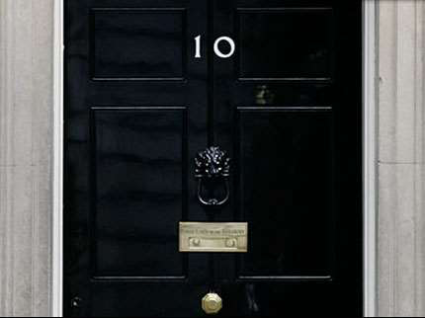
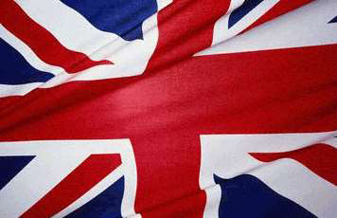
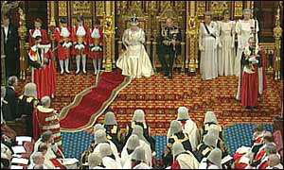
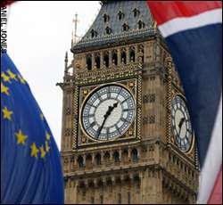
The Role of the Prime Minister

Slide 2
Sources of Prime Ministerial Power and authority
1.The Ruling Party
• The PM has the support of his party both in parliament and in the country in the form of ordinary members.
Since his party has won the right to govern, the PM carries his party’s elective authority with him.

Slide 3
2.The royal prerogative
The reigning monarch retains (in theory and law), the power to carry out the functions of
the head of state, such as commanding the armed forces.
In a democracy cannot allow an unelected monarch to exercise these powers and so the authority to exercise these
‘prerogative powers’ is delegated to the PM.

Slide 4
3.Popular mandate
Although technically the voters are choosing the MP and a party, they are also conscious
that they are electing a PM.
Research suggest that the leader of the party is becoming more and more in important when it comes to deciding who to vote for at an election. Thus,
The victorious PM can claim to enjoy the authority of the electorate.

Slide 5
4.Parliament
The PM is the parliamentary leader and as long as he has the support of a majority of the House of Common,
he can claim parliamentary authority.
Some PMs have enhanced the power gained with their own personal qualities to add to the four sources of authority.

Slide 6
Powers of the PM
• appoints ministers.
• allocates cabinet posts.
• reshuffles cabinet.
• dismisses ministers.
chairs cabinet meetings.
• manages the cabinet agenda.

Slide 7
• steers(directly), sums up and determines
outcome of cabinet discussions.
holds bilateral and informal meetings with
key ministers.
appoints chairs and members of cabinet
committees.
restructure central government.

Slide 8
authority as the leader of a political party
elected by MPs(Member of Parliaments) and party members.
enjoys a majority in the House of Commons.

Slide 9
Public Standing
high public profile communication-in-chief for the government.
political leaders in times of crisis.
represents country in international affairs.

Slide 10
Policy Making Role
directs government policy and sets the agenda.
authority to become involved in policy areas of
choosing.
takes the key role in times of crisis

Slide 11
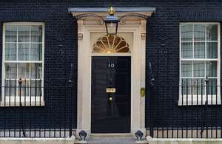
Prime Ministers’ Office
provides advice and support better enables PM to direct policy and act as a communicator.
appoints special advisers.
can reorganize the structure of the government.

Slide 12
Chief policy maker
Although his role is shared to some extent with other ministers, the cabinet and his party, the PM is completely pre-eminent in making the government’s policies.

Slide 13
Head of government
The PM is in charge of the machinery of government.
He can create new posts and new departments (as well as abolishing them).
He is the head of the Civil Service and
can seek advice from its vast machinery.
He chairs cabinet meetings, determining
their agenda and controlling the system of cabinet committees that underpins it.
The PM has the task of determining which individuals should hold posts as ministers,
senior judges and bishops/archbishops in the Church of England.

Slide 14
Chief government spokesperson
The PM is expected to be the ultimate source of the official version of government policy to the media.
The definitive version of policy MUST come from the PM.

Slide 15
Commander-in chief of armed forces
It is now solely the decision of the PM to whether or not to commit British troops to
Battle or to any other role. He may seek advice before he does this. E.g. Tony Bair has
committed British forces to action in Kosovo in 1998 to protect the Muslim population
from ethnic cleansing and in Iraq in 2003 to topple Saddam Hussein.

Slide 16
Chief foreign-policy maker
This function is carried out for the monarch. This can range from negotiating with
foreign powers to signing treaties to chairing international meetings. E.g. Blair chaired
meetings of the G8 of lading nations and took a leading role on issues such as global
warming and relief of poverty .

Slide 17
Parliamentary
Leader
The PM is responsible for leading his party in parliament in PMQs and other debates.
He also is in overall control of the government’s strategy within both houses.

Slide 18
conclusion
Providing direction for the government.
• Political and policy leadership.
• Making appointments to major public offices.
• Chairing the cabinet and steering its decisions.
• Answering Prime Minister’s Questions in the
House of Commons.
• Communicating the government’s message.
• Representing the country in international affairs.

Slide 19
THANK YOU

