Slide 1
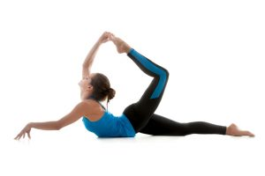
ACTIVE AND PASSIVE INSUFFICIENCY

Slide 2
INTRODUCTION
In a one-joint muscle, the excursion of the muscle will be greater than the range of motion allowed by the joint.
However, with a two-joint or multi joint muscle, the muscle’s excursion is less than the combined range allowed by the joints

Slide 3
The tension within the muscle becomes insufficient at both extremes.
It can neither be elongated nor shortened any farther.
Brunnstrom uses the terms active and passive insufficiency to describe these conditions.

Slide 4
ACTIVE INSUFFICIENCY
The point at which a muscle cannot shorten any further called active insufficiency.
Active insufficiency occurs to the agonist (the muscle that is contracting).
Consider the hamstrings as an example.
The hamstring muscles are two-joint muscles located on the posterior thigh.

Slide 5
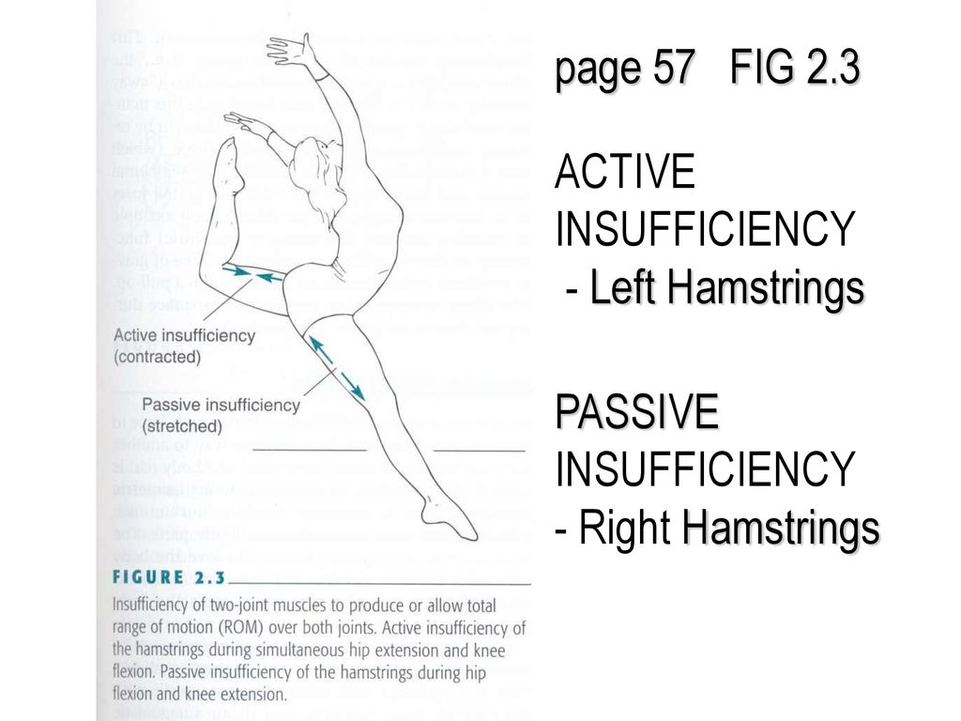

Slide 6
They extend the hip and flex the knee.
There is sufficient tension to perform either hip extension or knee flexion, but not both simultaneously.
Notice that if you flex your knee while your hip is extended, you cannot complete the full knee range.
The muscles have “insufficient power” to contract (shorten) over both joints at the same time.
They have become actively insufficient.

Slide 7
To see that more range of motion exists, grab your ankle and pull the knee into more flexion.
Be careful when trying this exercise that you do not get a muscle cramp.
In other words, in this two-joint muscle that is contracting over both joints at the same time, the muscle (hamstring) will run out of the contractility before the joints (hip and knee) run out of range of motion.

Slide 8
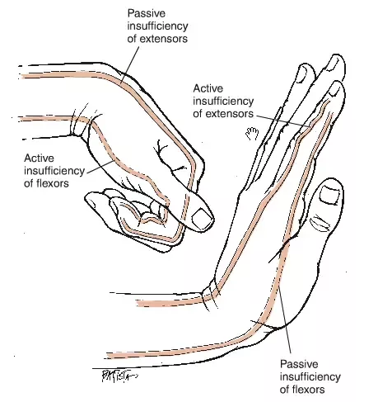

Slide 9
PASSIVE INSUFFICIENCY
Passive insufficiency occurs when a muscle cannot be elongated any further without damage to its fibers.
Passive insufficiency occurs to the antagonist (the muscle that is relaxed and on the opposite side of the joint from the agonist).

Slide 10
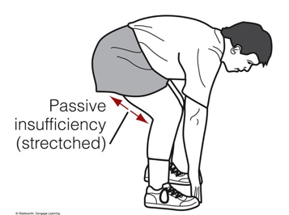

Slide 11
Consider the hamstring muscle as an example of passive insufficiency.
The hamstring is long enough to be stretched over each joint individually (hip flexion or knee extension), but not both.
If you flex your hip with your knee flexed, you can complete the range.

Slide 12
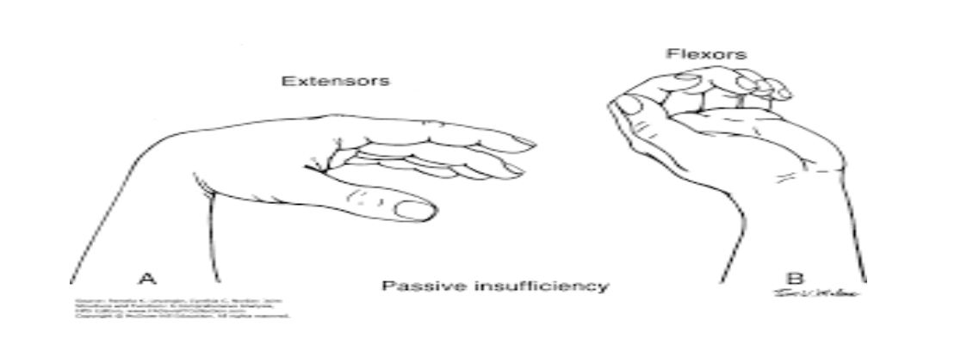

Slide 13
The hamstrings are being stretched over only one joint (the hip).
You can also extend your knee fully when the hip is extended because the hamstrings are being stretched over only the knee.
However, if you try to flex your hips to touch your toes with your knee extended you will experience pain in the posterior thigh well before you reach full hip flexion.

Slide 14
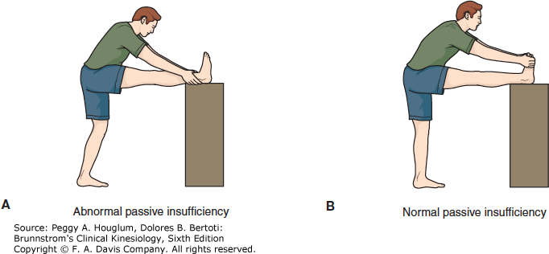

Slide 15
Your hamstring muscles are telling you to stop.
They are being stretched over both joints at the same time and have become passively insufficient.
They cannot be stretched any further.

Slide 16
TWO JOINT MUSCLES WORK

Slide 17
INTRODUCTION
Two Joint Muscles or TJM's are muscles that cross two joints of the body and therefore perform more than one joint function.
For example, the Rectus Femoris (considered one of the quads) actually crosses both the hip and knee joints and performs hip flexion and knee extension.

Slide 18
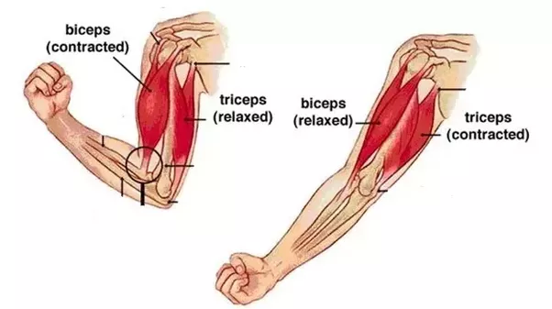

Slide 19
It both lifts and straightens your leg.
The gastrocnemius muscle, overlying soleus, has two heads: medial and lateral.
These heads join soleus at the tendo-Achilles, distally inserting on the calcaneus.
Gastrocnemius crosses two joints, working to plantar flex the ankle and to flex the knee.

Slide 20
The Sartorius and gracilis cross both the hip and knee joints as well.
Both attach very close to one another on the medial aspect of the proximal tibia, or lower leg.

Slide 21
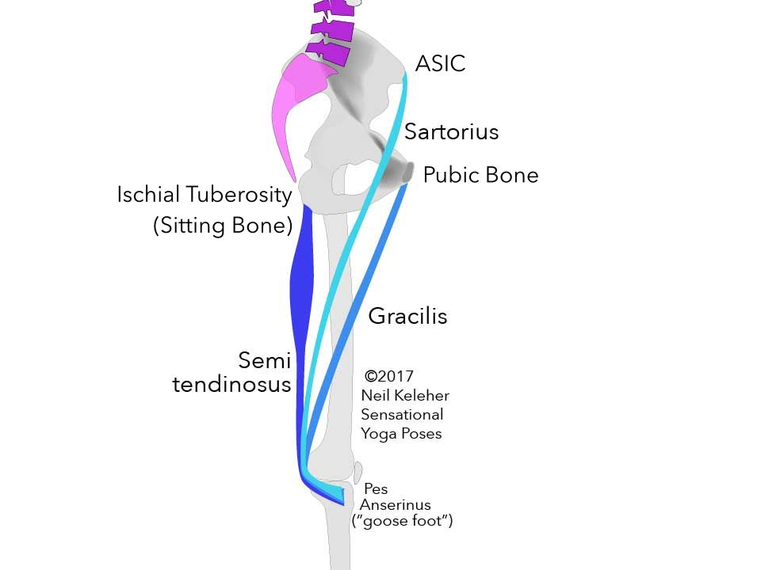

Slide 22


