Slide 1

Name: Shumaila
Registration no:
BA.LLB/1-21/M01068
Subject: Pakistan Studies
Presentation on:
Political & Constitutional phase of Pakistan 1971-1977
Instructor: Mr. Asim Mehboob

Slide 2
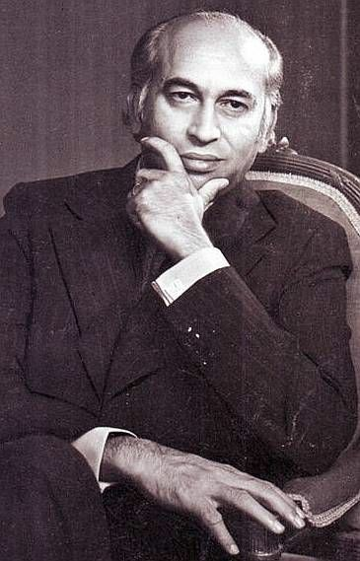
Political & Constitutional phase of Pakistan 1971-1977:
Zulfiqar Ali Bhutto Era:
After the 1970 elections, Pakistan faced civil war. As a result, on 16 December 1971, East Pakistan separated from West Pakistan and became the new independent state of Bangladesh.On December 20, 1971, Zulfiqar Ali Bhutto became the President of Pakistan as well as the Civil Martial Law Administrator. He was the country's first civilian martial law administrator.

Slide 3
Constitution of 1973 & Some Features:
The Constitution was enforced on 14, August 1973. this Constitution was consisted on 280 articles and 12 sections.
Islamic Provisions:
The Country name will be Islamic Republic of Pakistan.
Islam is the State Religion of Pakistan.
Only Muslim could become President and Prime Minister of Pakistan.
Islamic way of life.
Islamic laws.
Republican Form of Government:
According to the constitution, Pakistan will be an Islamic republic. The head of state will be elected by parliament in a joint session for a five-year term. He may be re-elected for another term also.

Slide 4
Protection of Minorities:
Government will provide full right to the minorities, they can spend their lives according to their own religion and culture.
National Language:
Urdu will be the national language of Pakistan.
Independent Judiciary:
Judiciary shall be independent and will work without any political and economic pressure.
Fundamental Rights:
The Constitution grants and protects the fundamental rights of the citizens of Pakistan. These include life, property, profession, freedom of thought and expression, religion, equality of citizens, etc.

Slide 5
The Economy Of Pakistan 1971-1977
Bhutto administration nationalized major industries ( steel ind, chemical ind, cement ind, insurance, domestic banks etc).
Bhutto believed in Socialism and started economy of state interference and planing.
This policy did contribute to the establishment of new industries, but failed to meet the expectations of the Bhutto.

Slide 6
Major events:
In 1972 Relations with India normalized.
April 14, 1972: First session of National Assembly.
April 21, 1972: Martial Law lifted, constitutional rule restored in the country.
In 1973 Begum Rana Liaquat Ali becomes first woman to assume office of Sindh Governor.
August 14, 1973: Constitution of Pakistan 1973 enforced.
In 1974 Pakistan recognized Bangladesh.
In 1974, Islamic Summit Conference starts in Lahore; 22 heads of state participate.

Slide 7

In 1974 Resolution passed about that Ahmadis and all groups of Ahmadis are Non-Muslim.
March 1, 1976: General Muhammad Zia-ul-Haq becomes Chief of Army Staff.
March 7, 1977: General elections held in the country and PPP wins.
July 5, 1977: General Zia-ul-Haq enforces Martial Law.
September 1977: Z. A. Bhutto arrested under Martial Law orders.

