Slide 1
SPINOTECTAL TRACT.
PRESENTED BY: MISMA FATIMA.
LECTURAR: DR. TEHREEM ANIS.

Slide 2
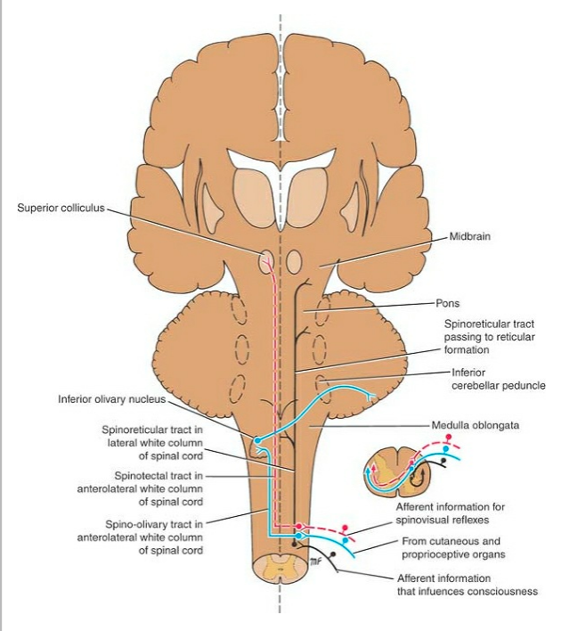
INTRODUCTION:
The spinotectal tract is a neural pathway that connects the spinal cord to the superior colliculus in the midbrain. It is part of the somatosensory system, which is responsible for processing sensory information related to touch, pain, temperature, and proprioception (the sense of body position and movement).

Slide 3
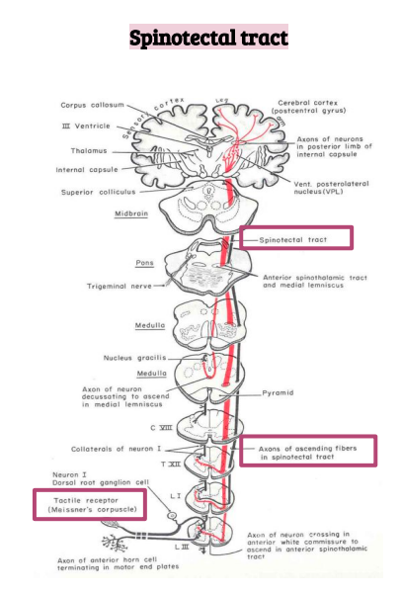
ORIGIN:
The spinotectal tract originates in the dorsal horn of the spinal cord, where sensory information from the skin, muscles, and joints is received.
TERMINATION:
The spinotectal tract terminates in the superior colliculus of the tectum in the midbrain, which is involved in the control of eye movements and other visual reflexes.

Slide 4
FUNCTION:
The spinotectal tract is involved in the processing of sensory information related to pain, temperature, and touch, and plays a role in the modulation of pain perception. It is also involved in the control of eye movements and other reflexes related to visual stimuli.

Slide 5
EFFECTS OF LESION:
A lesion or injury to the spinotectal tract can result in a variety of symptoms, depending on the location and extent of the damage.
Altered sensation:
A lesion in the spinotectal tract can result in altered sensation, such as a decrease in pain perception or a decrease in the ability to respond to noxious stimuli. Alternatively, it may lead to an increase in pain sensitivity .
Impaired eye movements and visual reflexes:
A lesion can result in impaired eye movements and visual reflexes, which may affect the ability to orient the head and body toward a visual target.

Slide 6
Muscle weakness, spasms, or tremors:
Depending on the location of the lesion, a person may experience muscle weakness, spasms, or tremors in the affected areas of the body.
Gait disturbances:
A lesion in the spinotectal tract may affect the ability to maintain balance and control body movements, leading to gait disturbances and an increased risk of falls.

Slide 7
REFERENCE:
https://www.kenhub.com/en/library/anatomy/ascending-tracts-of-the-spinal-cord
Snell's Clinical Neuroanatomy.

Slide 8


