Slide 1
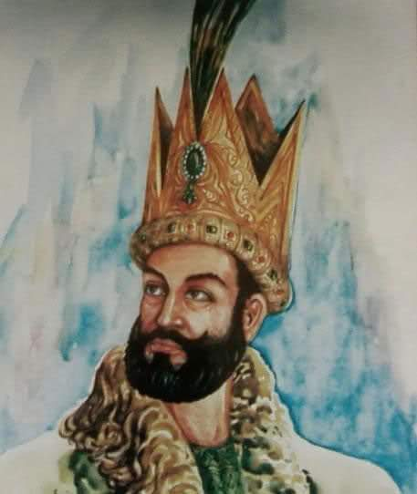
Mehmood ghaznavi

Slide 2
Introduction!
Mahmud was born in the town of Ghazni in the region of Zabulistan (now present-day Afghanistan) on 2 November 971. His father, Sabuktigin, was a Turkic slave commander who laid foundations to the Ghaznavid dynasty in Ghazni in 977.

Slide 3
Mahmud Ghaznavi is known as one of the greatest conquerors the world has ever seen. He was one of the very few leaders who were never defeated in a battlefield.Mahmud became the Sultan of Ghazni in 998. He inherited the small state of Ghazni from his father Subuktigin, and turned it into an empire that lasted for about a century. He was a brave man and use to take part in all the battles his forces fought.Though he was interested in extending his empire toward Central Asia, the maneuverings of the Hindu rulers of Punjab forced him to invade South Asia. He came to South Asia seventeen times and went back to Ghazni every time with a great victory. He fought against the strong forces of Jaipal, Annadpal, Tarnochalpal, Kramta and the joint forces of Hindu Rajas and Maharajas but all of them were forced to flee away from the battlefield due to Mahmud’s war strategy as a general.After the conquest of Multan and Lahore, Mahmud made Punjab a part of his empire in 1021.

Slide 4
Unlike other great conquerors like Alexander and Chengez Khan, Mahmud did not leave the areas conquered to the mercy of his soldiers. After becoming the first Muslim ruler to conquer Northern Punjab, he consolidated his rule in the area and established his provincial headquarters at Lahore. He established law and order in the areas that he ruled, giving special attention to the people he ruled. The department of police and post were efficient. His judicial system was very good as everybody was equal before the law and justice was the order of the day.

Slide 5
Mahmud was also a great patron of learning. His court was full of scholars including giants like Firdosi the poet, Behqi the historian and Al-Biruni the versatile scholar. It is said that he used to spend four hundred thousand golden Dinars on scholars. He invited the scholars from all over the world and was thus known as an abductor of scholars. Under Mahmud, Ghazni became one of the most important and beautiful cities of the Islamic world. It was the city of mosques, madrasas and libraries. He also established a Museum in Ghazni. During his rule, Lahore also became a great center of learning and culture. Lahore was called ‘Small Ghazni’. Saad Salman, a poet of those times, has written about the academic and cultural life of Lahore.

Slide 6
Mahmud was also a deeply religious man. He himself wrote a book on Fiqh. He had respect for other religions. A large number of Hindus lived in Ghazni, and they enjoyed religious freedom. One of his commanders named Tilak was a Hindu. A number of soldiers in his army were also Hindus. Mahmud attacked the Hindu Temples in India because of political and not religious reasons.
Mahmud Ghaznavi died on April 30 1030.

