Slide 1
Marketing Management
Lecture # 1
Date:26 January 2020
From the desk of Shehzadi Haleema

Slide 2
Chapter -1
Marketing: Defining marketing for the 21st century
Author Name: Philip Kotler 14TH EDITION

Slide 3
DISCUSSION QUESTION
1. What is Marketing?
2. What is the importance and scope of marketing?
3. What is the evolution of marketing management?
4. What is the marketing concept and social responsibility?
5.What is the basic function of marketing?
6. What are the task necessary for successful marketing
management?

Slide 4
What is marketing?
Marketing is not just selling and advertising!
SIMPLEST DEFINATION:
Satisfying Customer needs.
Marketing: An organizational function and a set of processes for
creating, communicating, and delivering value to customers and for
managing customer relationships in ways that benefit the
organization and its stakeholders.

Slide 5
What is marketing? Cont..
Marketing Management: The art and science of choosing
target markets and getting, keeping, and growing
customers through creating, delivering, and
communicating superior customer
value.

Slide 6



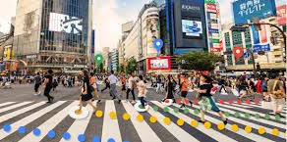
WHO IS MARKETED?
Goods
Services
Experiences
Events
Persons
Places
Properties
Organizations
Information
Ideas

Slide 7
WHO MARKETS?
MARKETERS AND PROSPECTS A marketer is someone who seeks a response—attention, a purchase, a vote, a donation—from another party, called the prospect. If two parties are seeking to sell something to each other, we call them both marketers.

Slide 8
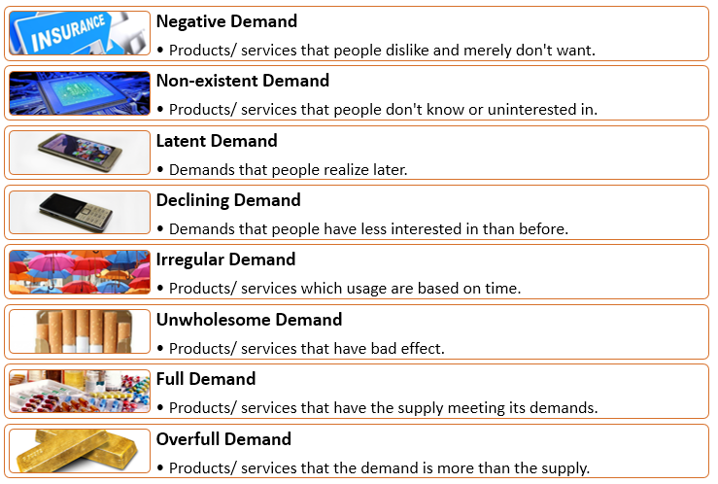
Type of demand

Slide 9
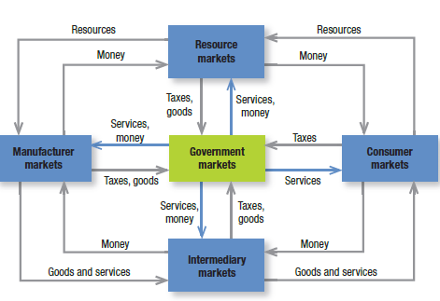
MARKETS

Slide 10
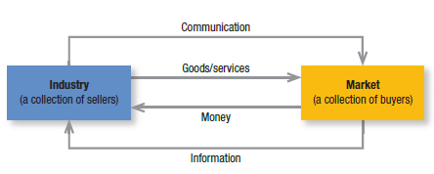
Simple marketing system

Slide 11
Key customer market
Consumer Market: Company selling mass consumer goods and services
Business Market: Companies selling business goods and services
Global Market: Company in the global marketplace must decide which countries to enter; how to enter each; how to adapt product and service features to each country; how to price product in different country; and hoe to design communications for different cultures.
Non-Profit and Governmental Markets: Companies selling product to non-profit organization with limited purchasing powers such as; universities, charitable organizations.

Slide 12
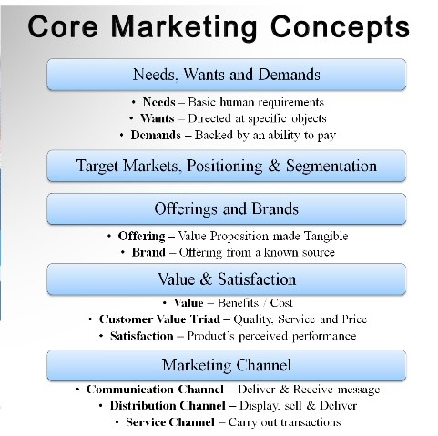

Slide 13
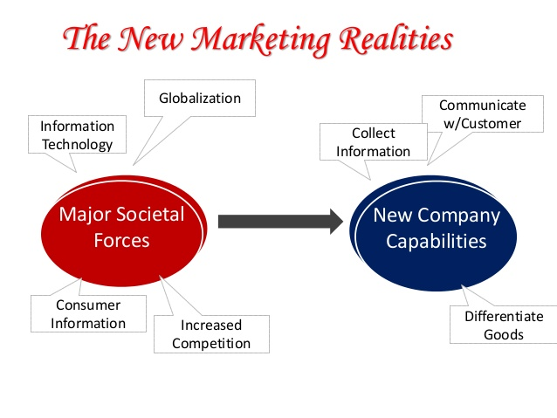

Slide 14
CORE Concepts OF MARKETING MANAGEMENT
Production Concept
Product Concepts
Selling Concept
Marketing Concept
Societal Concept

Slide 15
Production Concepts
The company following the production concept believes in the fact that it should produce goods efficiently and try to bring down the prices so that products become affordable
The firm undertakes mass production and makes an effort to improve the distribution.

Slide 16
Product Concepts
According to this concept. People like products which are very good in terms of performance and quality.
The company aims at making a continuous effort towards products improvement and innovation.

Slide 17
selling Concepts
According to this concept the company’s entire focus is on selling, hence making a lot of sales.
The selling effort is backed by serious promotion and advertising.
The company does not bother about the market demand, they just want to sell what they product.

Slide 18
Marketing Concepts
The marketing concept is concerned with:
- First identifying the customer needs and
- then making products that give maximum customer satisfaction
Marketing starts before the product, or service is ready and continues even after the sale has been made.
The firm here aimsto make products and provide services better than the competitors.

Slide 19
Marketing Concepts cont…
The company makes sincere efforts towards retaining the customers and also attracting new ones.
If the customers are satisfied with the product, they will but it again and again and also tell other people about it.
The job is not to find the right customers for your product, but the right products for your customers.

Slide 20
Societal concept
Societal concept focuses on consumer needs and wants, profits and the social welfare. Thus helps in improving the image of the company.
The firm are concerned with social issues like environment problems and pollution caused by the waste material, health problems caused by fast food etc.
Balances human welfare, company profits and consumer satisfaction.

Slide 21
New Market orientation
Holistic Marketing Concept
The holistic marketing concept is based on the development, design and implementation of marketing process, programs and activities that recognize their breadth and interdependencies.

Slide 22
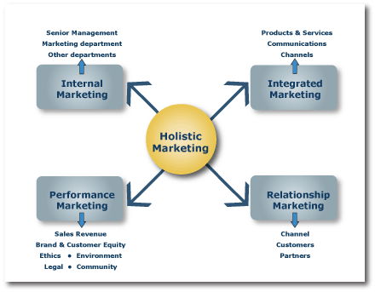
Four component of holistic marketing

Slide 23
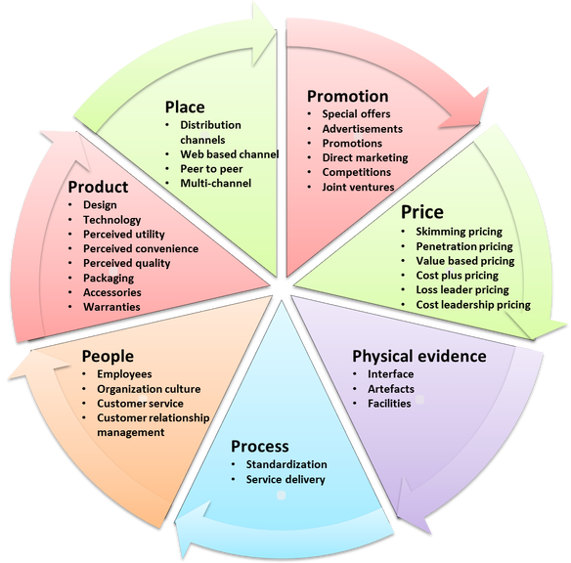
7 P’S MARKETING MIX

Slide 24
Marketing management tasks
Developing marketing strategies & plans
Capturing marketing insights
Connecting with customers
Building strong brands
Shaping the market offerings
Delivering value
Communicating value
Creating long-term growth

